Slide 1
Plane Spotting 3 Or Opening Emergency Exit Doors at Inappropriate Times since 1985.
Predicting Air Delays at SeaTac airport.
A CS 773C Project by Sam Delaney

Slide 2
The Problem!
A Review!

Slide 3
The Problem
Is it possible to predict whether a flight will be delayed at time of ticket purchase out of Seattle Tacoma International Airport?

Slide 4
Recap of Previous Work.
Cheating makes things easy!
It is easy to predict within 6 hours of flight
Many attributes help in delay prediction but are not available to the ticket buyer.

Slide 5
Data Preparation
One year’s worth of data from SeaTac airport
Over 300,000 flights
To much for weka…
First randomize set
Then grab 10% sample

Slide 6
Features Used
Month
Day
Day of Week (Monday)
Airline
Destination Airport
Origin flight (If Applicable)

Slide 7
Results!
Why we are all here.

Slide 8
First the binning!
Bin intervals for delay
1Hour intervals? Too easy, 95.28% accuracy on J48
Same as ZeroR
1 leaf tree
10 min intervals? 52.82% accuracy on J48
3,412 leaves
Okay, let’s see what we can do

Slide 9
Zero R baseline
45.65% Accurate
Rule was to predict roughly no delay and not early (-5 to 5 min delay time)

Slide 10
J 48 Results
52.82% Accuaracy
Tree Breakdown
Carrier
Destination
Month
Day of Week

Slide 11
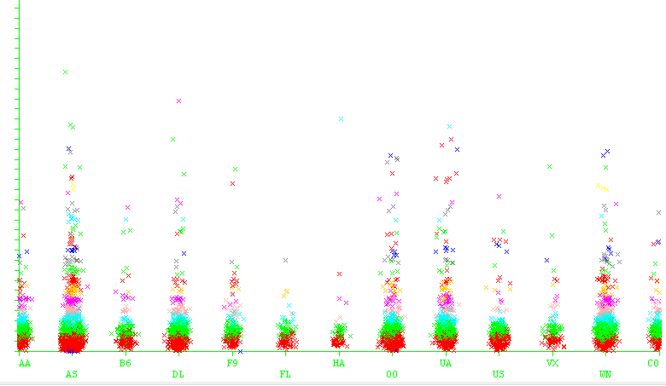
Carrier vs Delay Time

Slide 12
Random Forest
10 Trees
6 Random Attributes
Unlimited depth
48.17% Accuracy
Confusion matrix was not terrible, most misclassifications were only off by ~10mins.

Slide 13
JRIP Rules
51.66% accuracy
Only 12 rules!

Slide 14
Decision Table
Interesting rule set
Rule was
Carrier
Where you going?
BOOM! Delay prediction.
54.48% Accuracy!
124 rules

Slide 15
Boost Me!
Had to reduce number of instances
Stupid weka
64.49% Accuracy!
Moving on up
J48 Boost
10 iterations
3 Subcommittees
1,199 leaves in tree

Slide 16
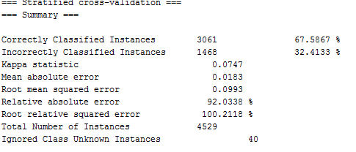
Naïve Biased
I’ll let the picture speak for itself

Slide 17
For Funnsies
Kstar – 66.08%
Adaboost
Decision Stump
69.9%
Trying other boosts didn’t work as Weka gave up unless I had only 1000 instances or less and accuracy went throw the floor ☹

Slide 18
Conclusion
Weka improvement for larger data sets would be nice
Results were pleasantly surprising!
~70% accuracy with 10 min intervals (roughly 50 bins)
Though I don’t think they are ready for iPhone apps just yet

Slide 19
Future Work
Does this hold true for other airports?
How accurate of a weather model can be strung up 6 months out?
How would this affect ticket purchase if predictability could be greater than 90%?

Slide 20
Questions?

